Slide 1
Synchronous Binary Irregular Counters
Submitted by:-
Name: Nafinur Leo
Id: 20-42195-1
Section: G

Slide 2
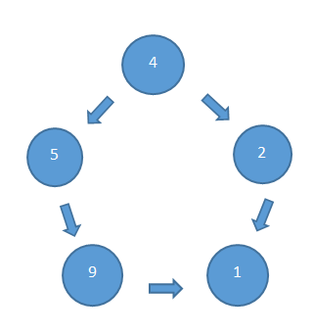
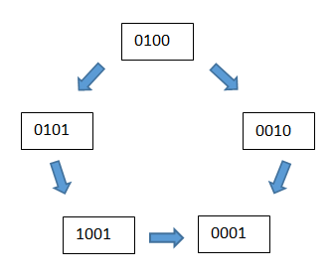
Decimal and Binary sequence:-

Slide 3
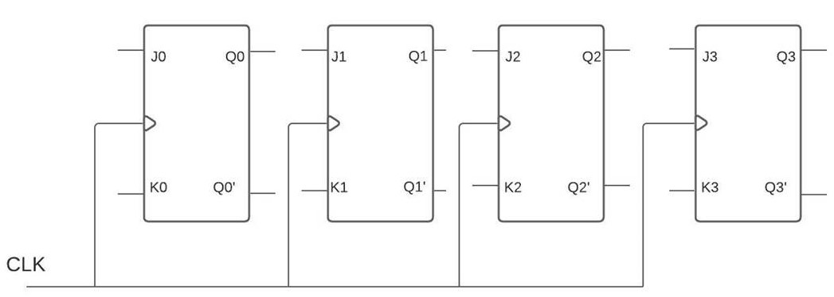
The number of flip-flop:-

Slide 4
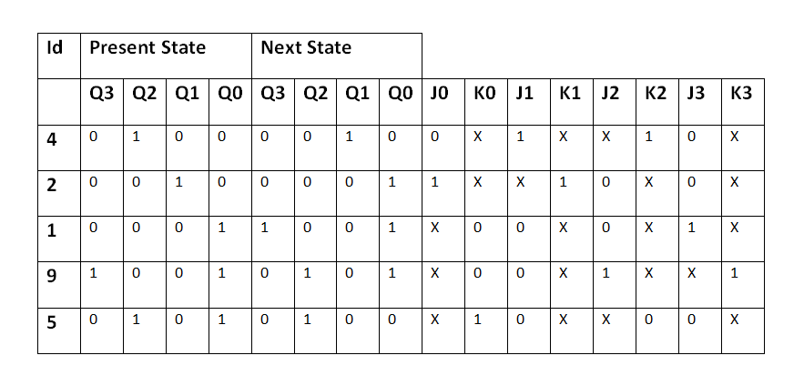
Counter table:-

Slide 5
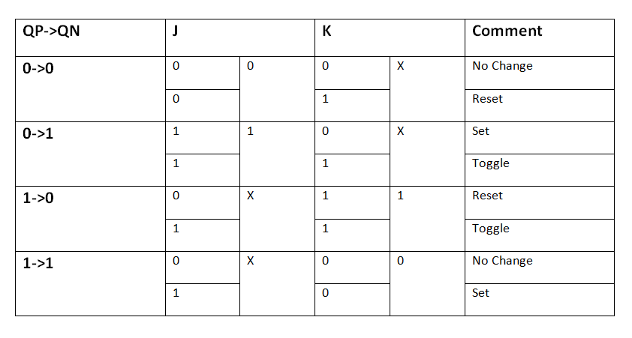
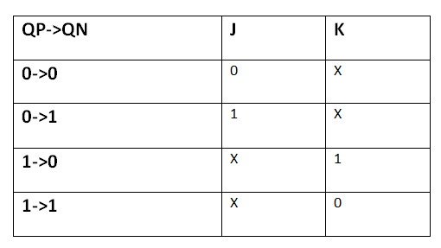
Transition table:-

Slide 6
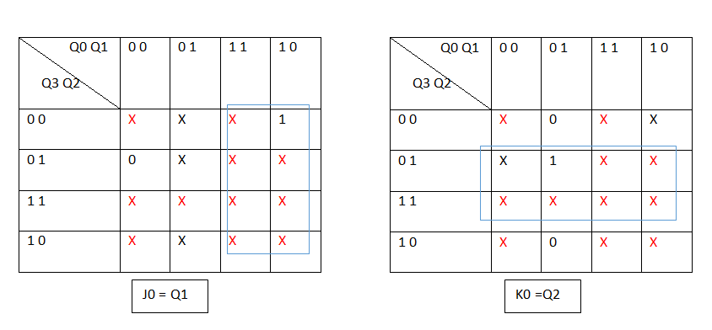
Filling up K-MAPs

Slide 7
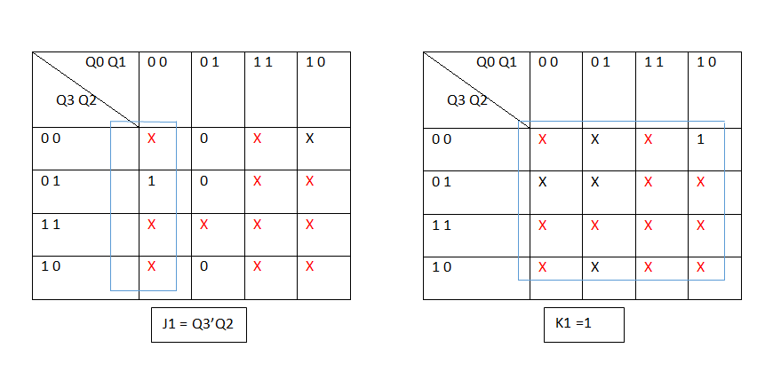
Filling up K-MAPs

Slide 8
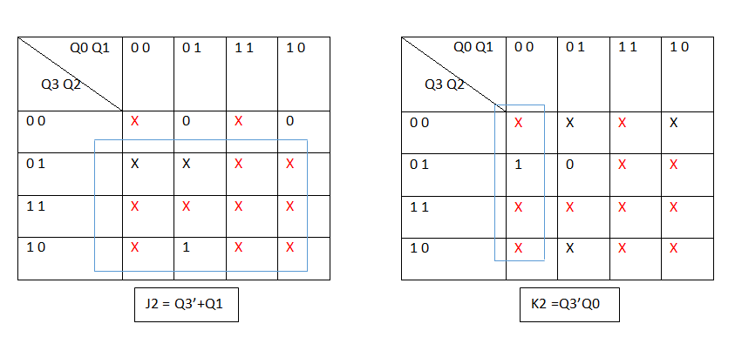
Filling up K-MAPs

Slide 9
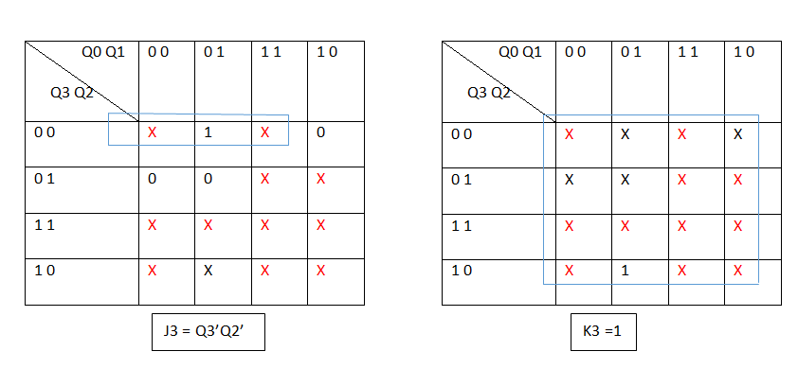
Filling up K-MAPs

Slide 10
Final output connections
J0 = Q1
J1 = Q3’Q2
J2 = Q3’+Q1
J3 = Q3’Q2’
K0 = Q2
K1 = 1
K2 = Q3’Q0
K3 = 1

Slide 11
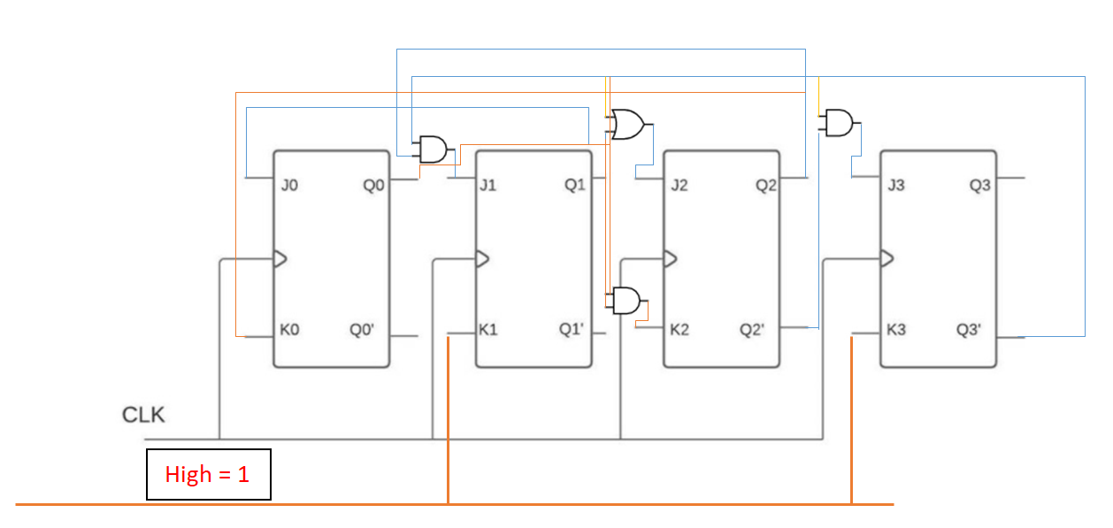
Connecting the output connections in the diagram

